Slide 1

Binary Search On Answer

Slide 2

Agenda
Introduction to Binary Search on Answer
Traditional Binary Search vs Answer-based Binary Search
Problem Example: Minimum Maximum Pages
Range Setup for Binary Search
Feasibility Function – Design & Code
Main Binary Search Logic – Code
Time and Space Complexity
Feasibility Curve Visualization
Similar Pattern-Based Problems
Common Pitfalls & Edge Cases
Top Practice Problems
Conclusion & Best Practices

Slide 3
Introduction
Definition: Binary Search on Answer is a technique where we apply binary search on the range of possible answers rather than a sorted array.
When to Use:
The answer lies within a numeric range.
You can check the feasibility of a proposed answer.
The feasibility function is monotonic (if x is feasible, all greater than x are feasible or vice versa).

Slide 4
Comparison Table
Feature | Traditional Binary Search | Binary Search on Answer
Used on | Sorted arrays | Answer range ([low, high])
Goal | Find element/position | Find optimal feasible answer
Requires sorted data? | Yes | No
Example | Find x in arr | Minimize max pages

Slide 5
Problem Example – Minimum Maximum Pages
Given: N books with pages, M students.
Goal: Assign books (contiguously) such that the maximum pages assigned to any student is minimized.
Input: pages = [10, 20, 30, 40], M = 2
Output: 60

Slide 6
Binary Search Range Setup
Low = max(pages) = 40
High = sum(pages) = 100
Binary search will be applied on this range to find the minimum valid max-pages.

Slide 7
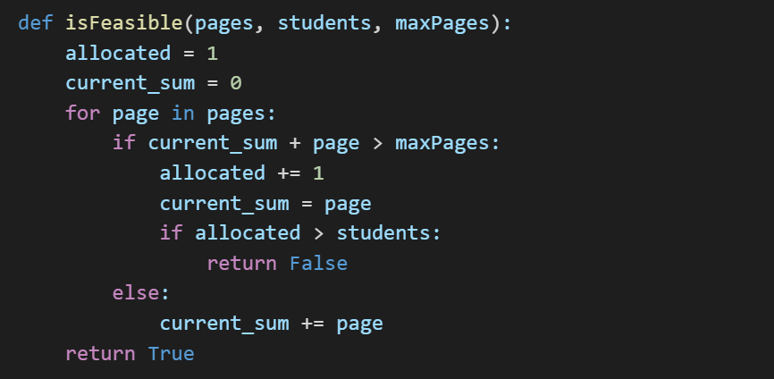
Feasibility Function
True: valid distribution possible within maxPages.
False: exceeds allowed students.

Slide 8
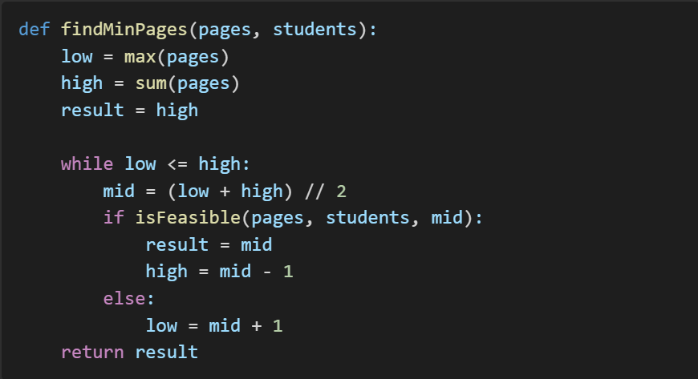
Main Binary Search Code

Slide 9
Time Complexity Analysis
Binary Search Steps: log(high - low)
Feasibility per step: O(N)
Total: O(N * log(sum - max))
Space: O(1)

Slide 10

Visualization
Feasibility Curve:
Find first True: the minimal feasible solution.

Slide 11
Similar Problems
Problem | Goal
Aggressive Cows (GFG) | Maximize minimum distance
Koko Eating Bananas (Leetcode 875) | Minimize eating speed
Capacity to Ship Packages (Leetcode) | Minimize max weight per day
Painter Partition | Minimize max units/time
Split Array Largest Sum (Leetcode 410) | Minimize largest subarray sum

Slide 12
Common Pitfalls
Do not start with low = 0. Start with max(arr).
Handle edge cases where students > books.
Ensure integer mid calculation in other languages.

Slide 13
Conclusion
Binary Search on Answer is ideal for optimization problems.
Feasibility function is key.
Efficient, clean, and powerful for interviews and contests.

Slide 14
THANK YOU

